Slide 1

ANALYZING SWIGGY Bangalore Outlet
Project Report by
Ruchita patel

Slide 2
Introduction
Swiggy is an Indian online food ordering and delivery platform. Founded in July 2014, Swiggy is based in Bangalore and operates in 500 Indian cities as of September 2021.
Besides food delivery, Swiggy also provides on-demand grocery deliveries under the name Instamart, and a same-day package delivery service called Swiggy Genie.

Slide 3
Problem Statement
The online food ordering market includes foods prepared by restaurants, prepared by independent people, and groceries being ordered online and then picked up or delivered. Online food ordering is the process of ordering food from a website or other application. The product can be either ready-to-eat food or food that has not been specially prepared for direct consumption. Do ETL: Extract-Transform-Load the dataset and find some information from this large data. This is a form of data mining. Find key metrics and factors and show the meaningful relationships between attributes.

Slide 4
Cases Studied
Top 10 Restaurants by Rating
Top 10 Cuisines ordered
Total Restaurants with respect to location.
Cost vs Rating
Top 10 Restaurants with minimum cost
Top 10 Restaurants with maximum cost

Slide 5
Approaches
Python: Used for Data Cleaning
Tableau: Used for creating Dashboards and Story - (https://tinyurl.com/ujtrw8n4)

Slide 6
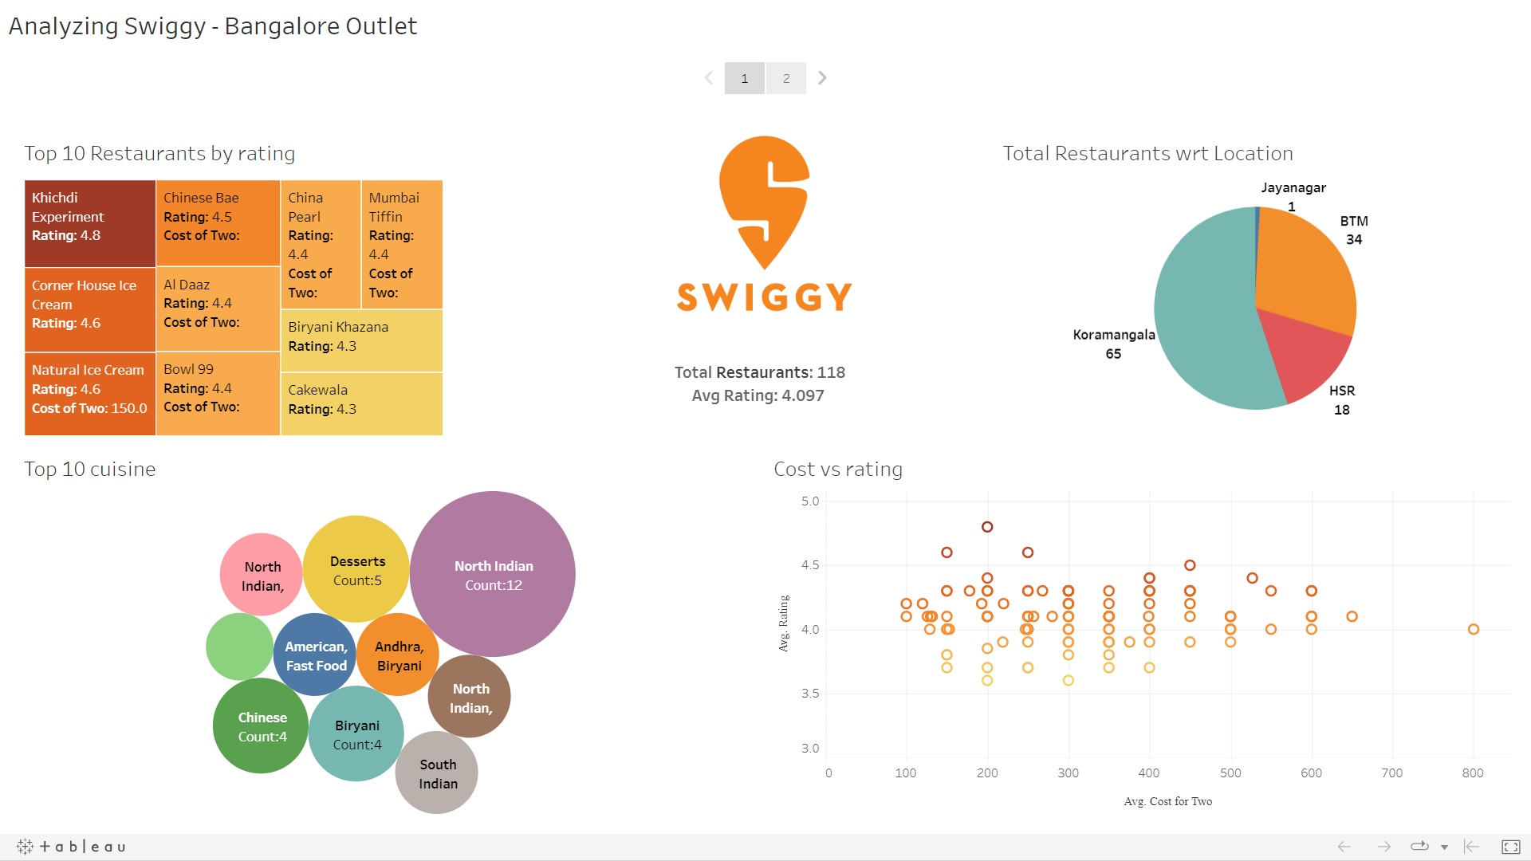
My Design

Slide 7
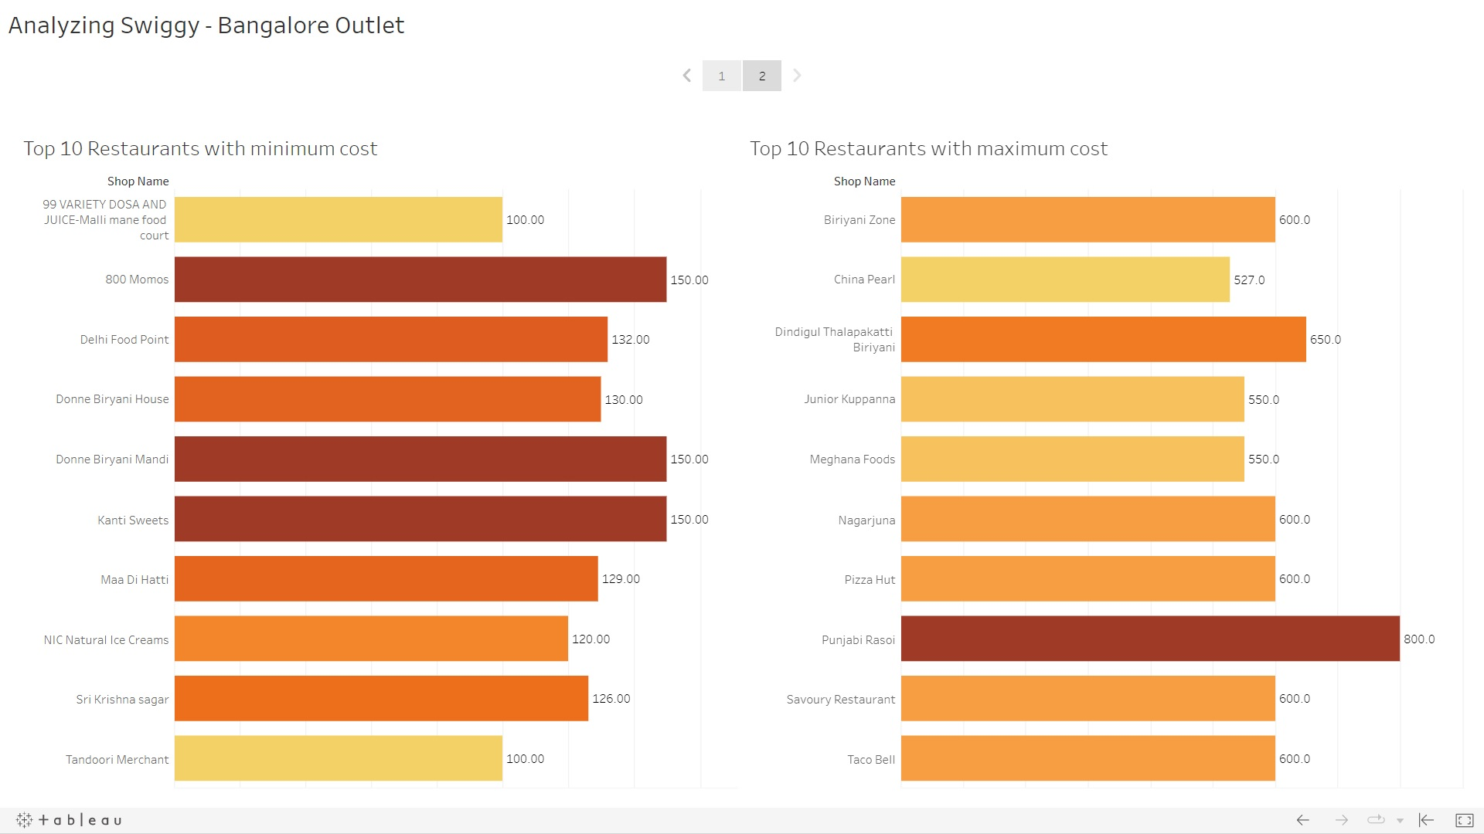
My Design

Slide 8
Thank You

